Slide 1
Seminar III: Rail Transportation Issues
Preparing for Tomorrow
Northeast Agribusiness and Feed Alliance Annual Forum
February 7, 2017
Albany, NY

Slide 2
NGFA Fast Facts
More than 1,000-Member Companies:
Grain elevators
Feed, feed ingredient manufacturers
Oilseed processors
Flour, corn mills
Biofuels producers
Many other related agribusinesses
26 State/Regional Associations – Including Tennessee Feed and Grain Association
Strategic Alliances with PFI, NAEGA
Members
Handle 70%
of U.S. Grains and Oilseeds

Slide 3
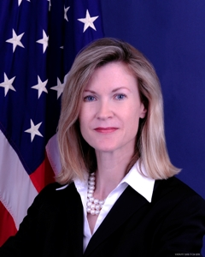
Rail Issues
New Leadership at STB –
Acting Chairman Ann Begeman
Serving second, 5-year term; background with Senate Commerce Committee; agricultural roots
Goals:
Change STB procedural rules to allow ex parte communications with stakeholders on cases
Committed to creating simplified, cost-effective process for small shippers to challenge unreasonable rail rates
Two Vacancies Awaiting Nominations
Expanded under STB Reauthorization Act of 2015
Both Republican seats

Slide 4
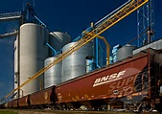
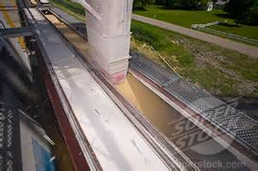
Rail Issues
Key STB Proceedings
Reciprocal switching
Creat workable rail rate challenge process for grain, agricultyural shippers
NGFA Exploring Expansion of Rail Arbitration to Apply to Rates

Slide 5
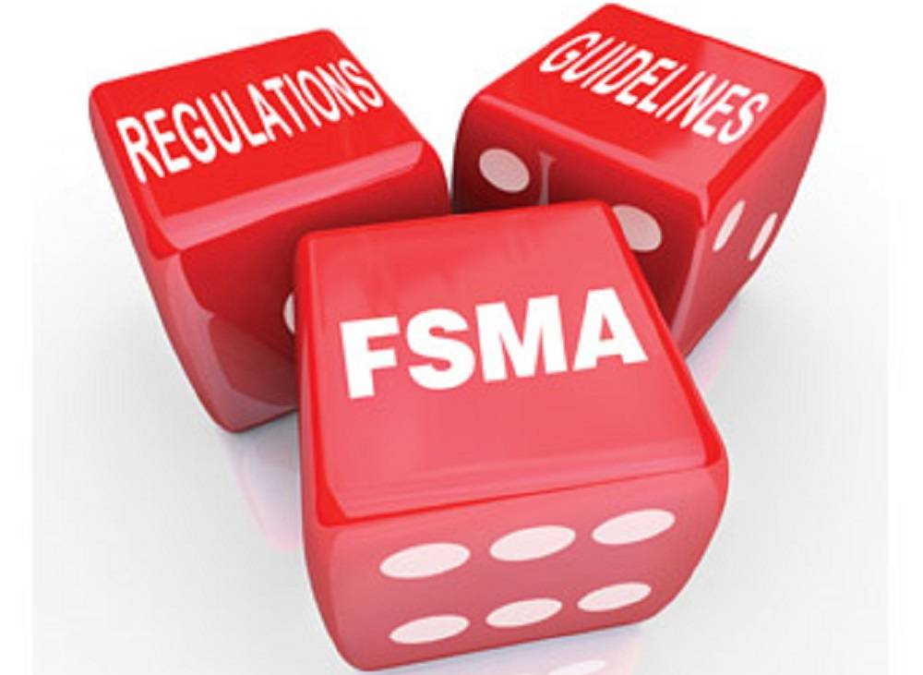
FDA Sanitary Food Transportation Rule
Included within FSMA
Applies to rail and truck transport; food safety (not quality)
Sets requirements for shippers (includes brokers), receivers, loaders, RRs, truckers
Virtually all responsibilities placed on shippers, unless delegated to RR or trucker through written agreement
Assure vehicles, equipment in appropriate sanitary condition appropriate for food, feed, ingredients being hauled
Shipper required to provide one-time written notification to carrier and (if necessary) the loader of sanitary specifications necessary
Shippers required to keep records of written procedures to ensure previous cargo hauled does not make food, feed unsafe
Loaders required to ensure conveyance in “appropriate sanitary condition” prior to loading
Effective Dates:
Large Companies: April 6, 2017
Small Companies (500 or fewer employees): April 6, 2018
Very Small Companies (less than $500,000 annual sales avg. over 3 years): Exempt

Slide 6
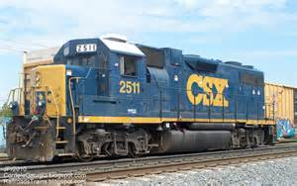
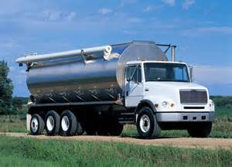
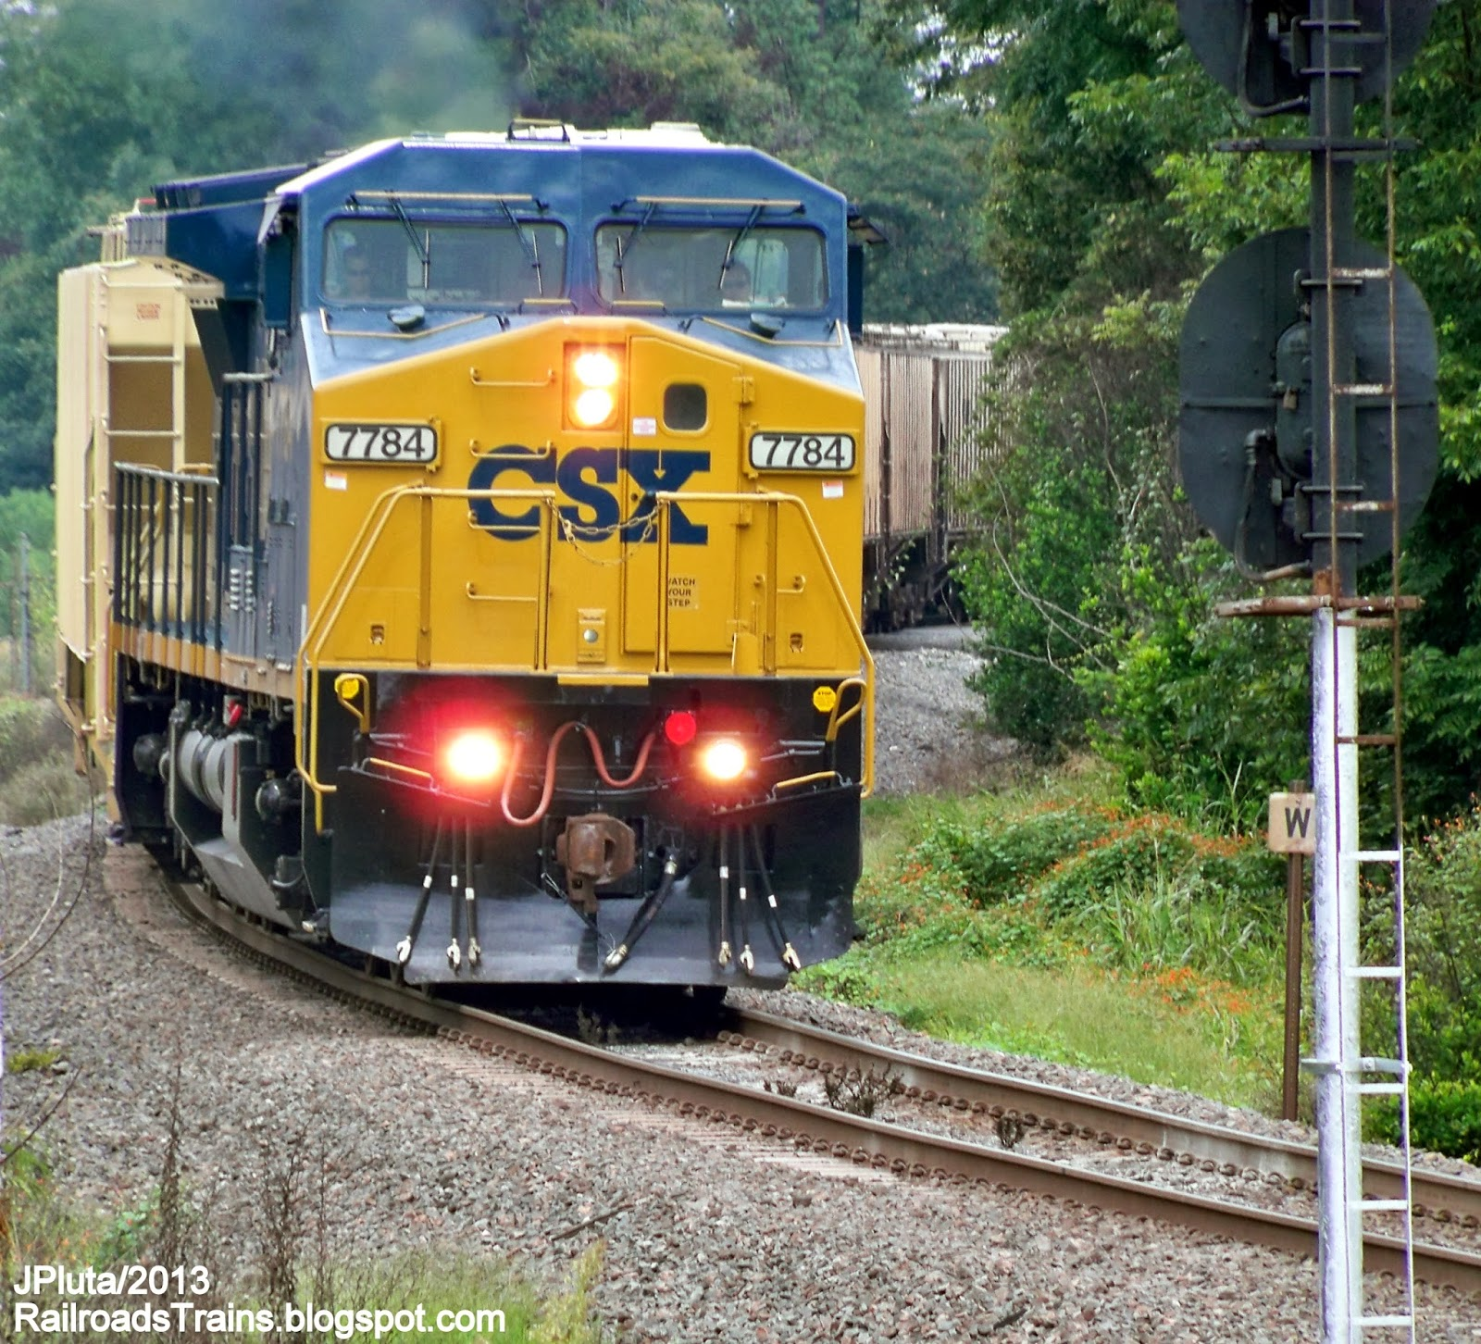
FDA Sanitary Food Transportation Rule
Major Problem with FDA Rule
Shippers required to notify RR, trucker of the type and sanitary condition of conveyance appropriate for product being hauled, and to ensure previous loads do not cross-contaminate product
BUT rail carrier, trucker under no obligation to:
Provide type of conveyance requested
Provide information on last load(s) hauled
Provide information on conveyance clean-out
UNLESS rail carrier or trucker agrees to sign written agreement with shipper to do so

Slide 7
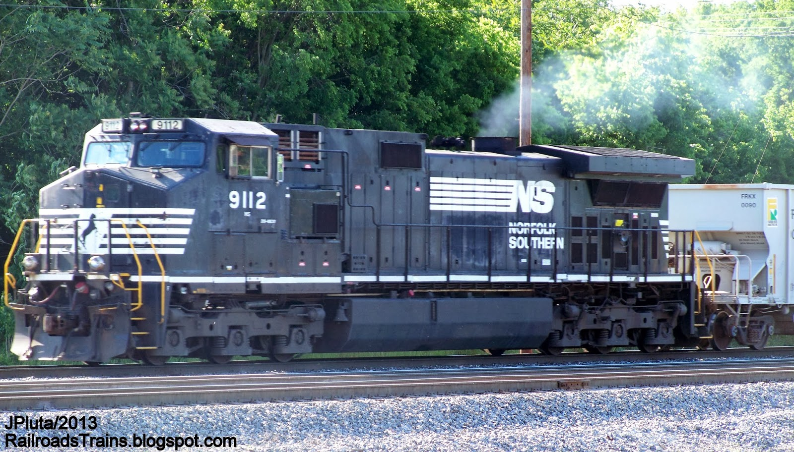
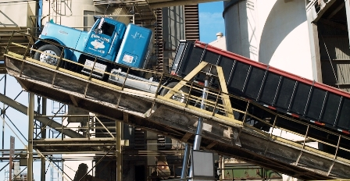
FDA Sanitary Food Transportation Rule
Action Taken:
NGFA, NAMA, NOPA filed petition urging FDA to impose a stay on rule’s effective date (April 6, 2017 for large companies); met with FDA in July
Meeting with FDA, RRs and truckers planned for late February

Slide 8
Highway Law
Truck Weight Limit: 80,000 lbs. federal truck weight limit on Interstate highways still in place
Electronic Logs: Devices required by December 2017 for all drivers currently required to complete paper logs
Truck Driver ‘Coercion’ Rule: Motor carriers, shippers, receivers, brokers prohibited from coercing truck drivers to violate truck regulations, such as hours-of-service rules
Effective Jan. 29, 2016
As a prerequisite to filing coercion claim, driver must inform that regulation will be broken
$16,000 fine per violation
Commercial Drivers License: Drivers required to complete a training program that includes both behind-the-wheel and classroom instruction through a FMCSA-approved training provider before taking CDL test (Effective Feb. 7, 2020)

Slide 9
Seminar III: Rail Transportation Issues
Thank You!
Randy Gordon, President
National Grain and Feed Association
202-289-0873; rgordon@ngfa.org

